Slide 1
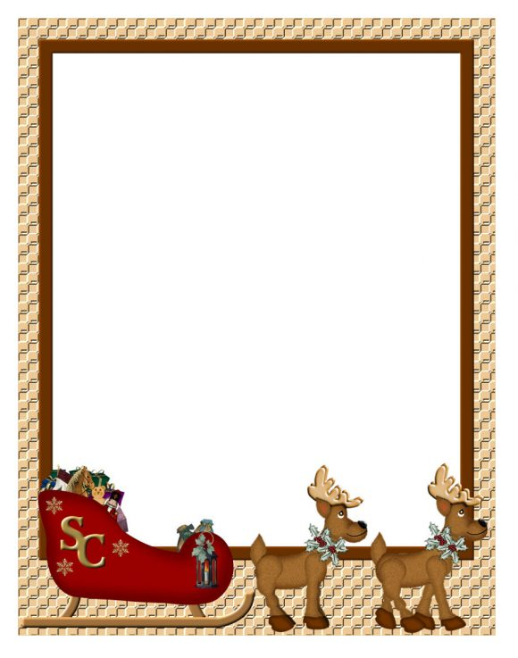
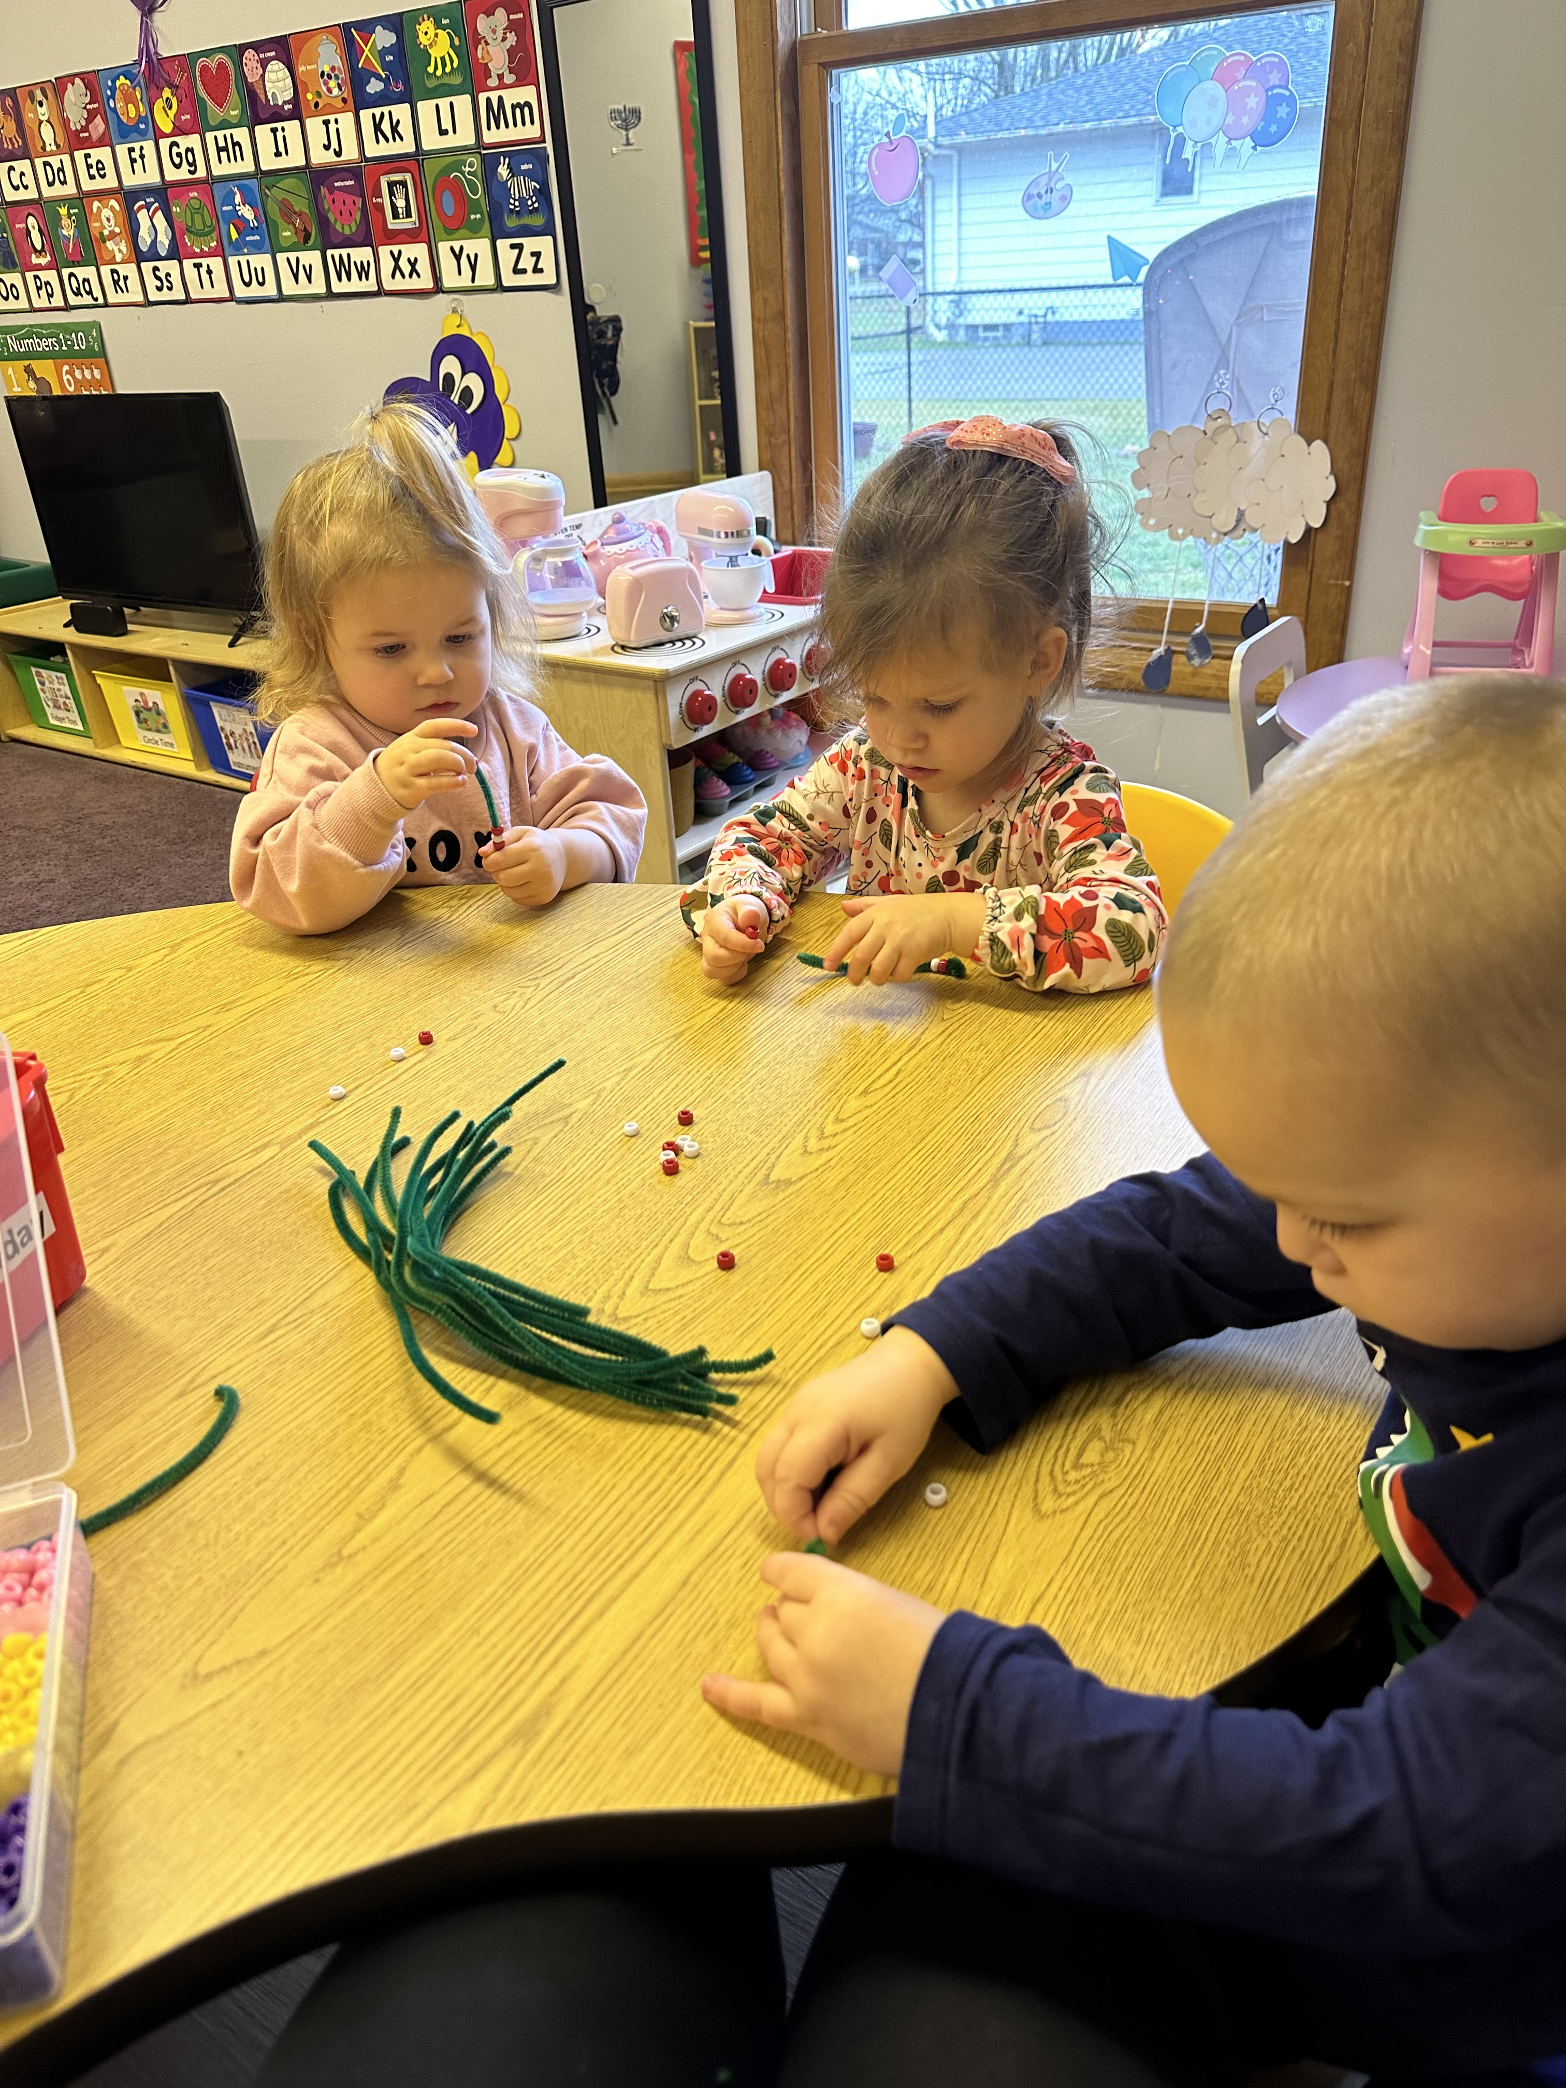
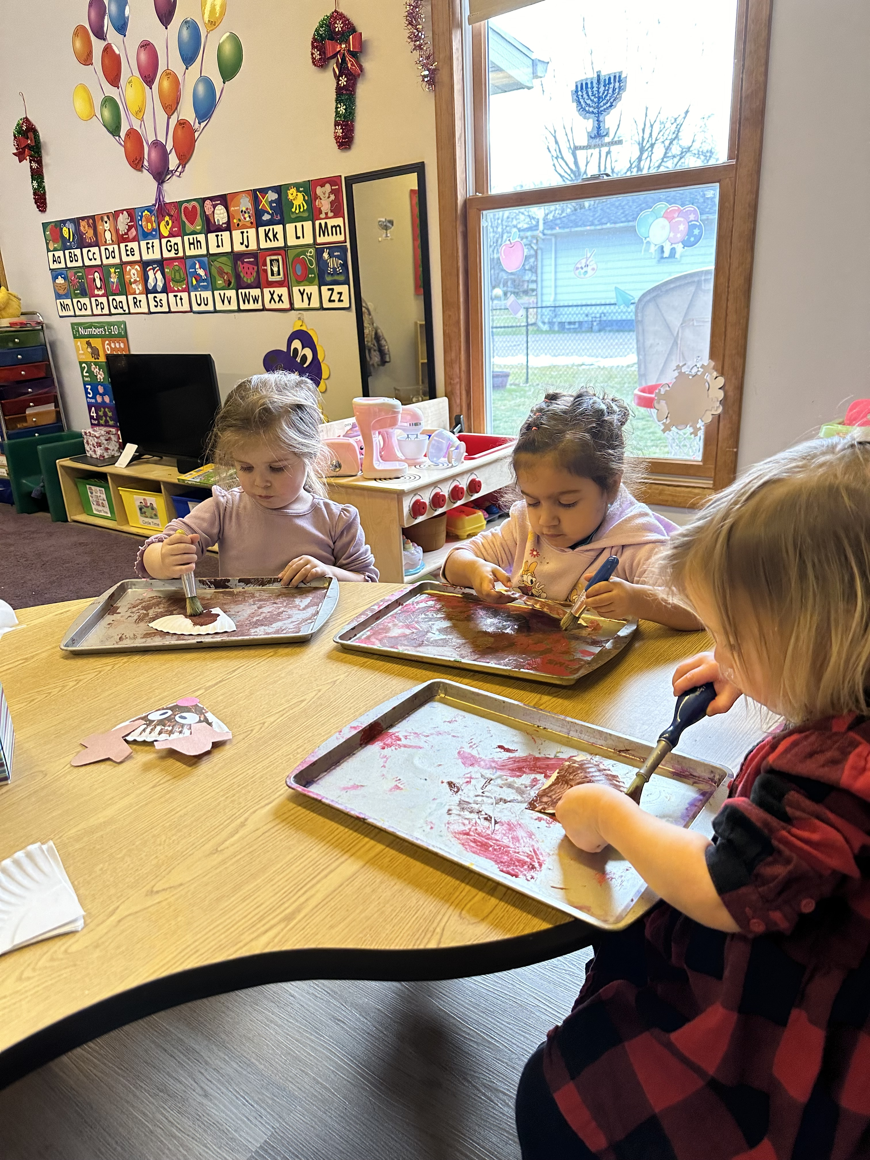
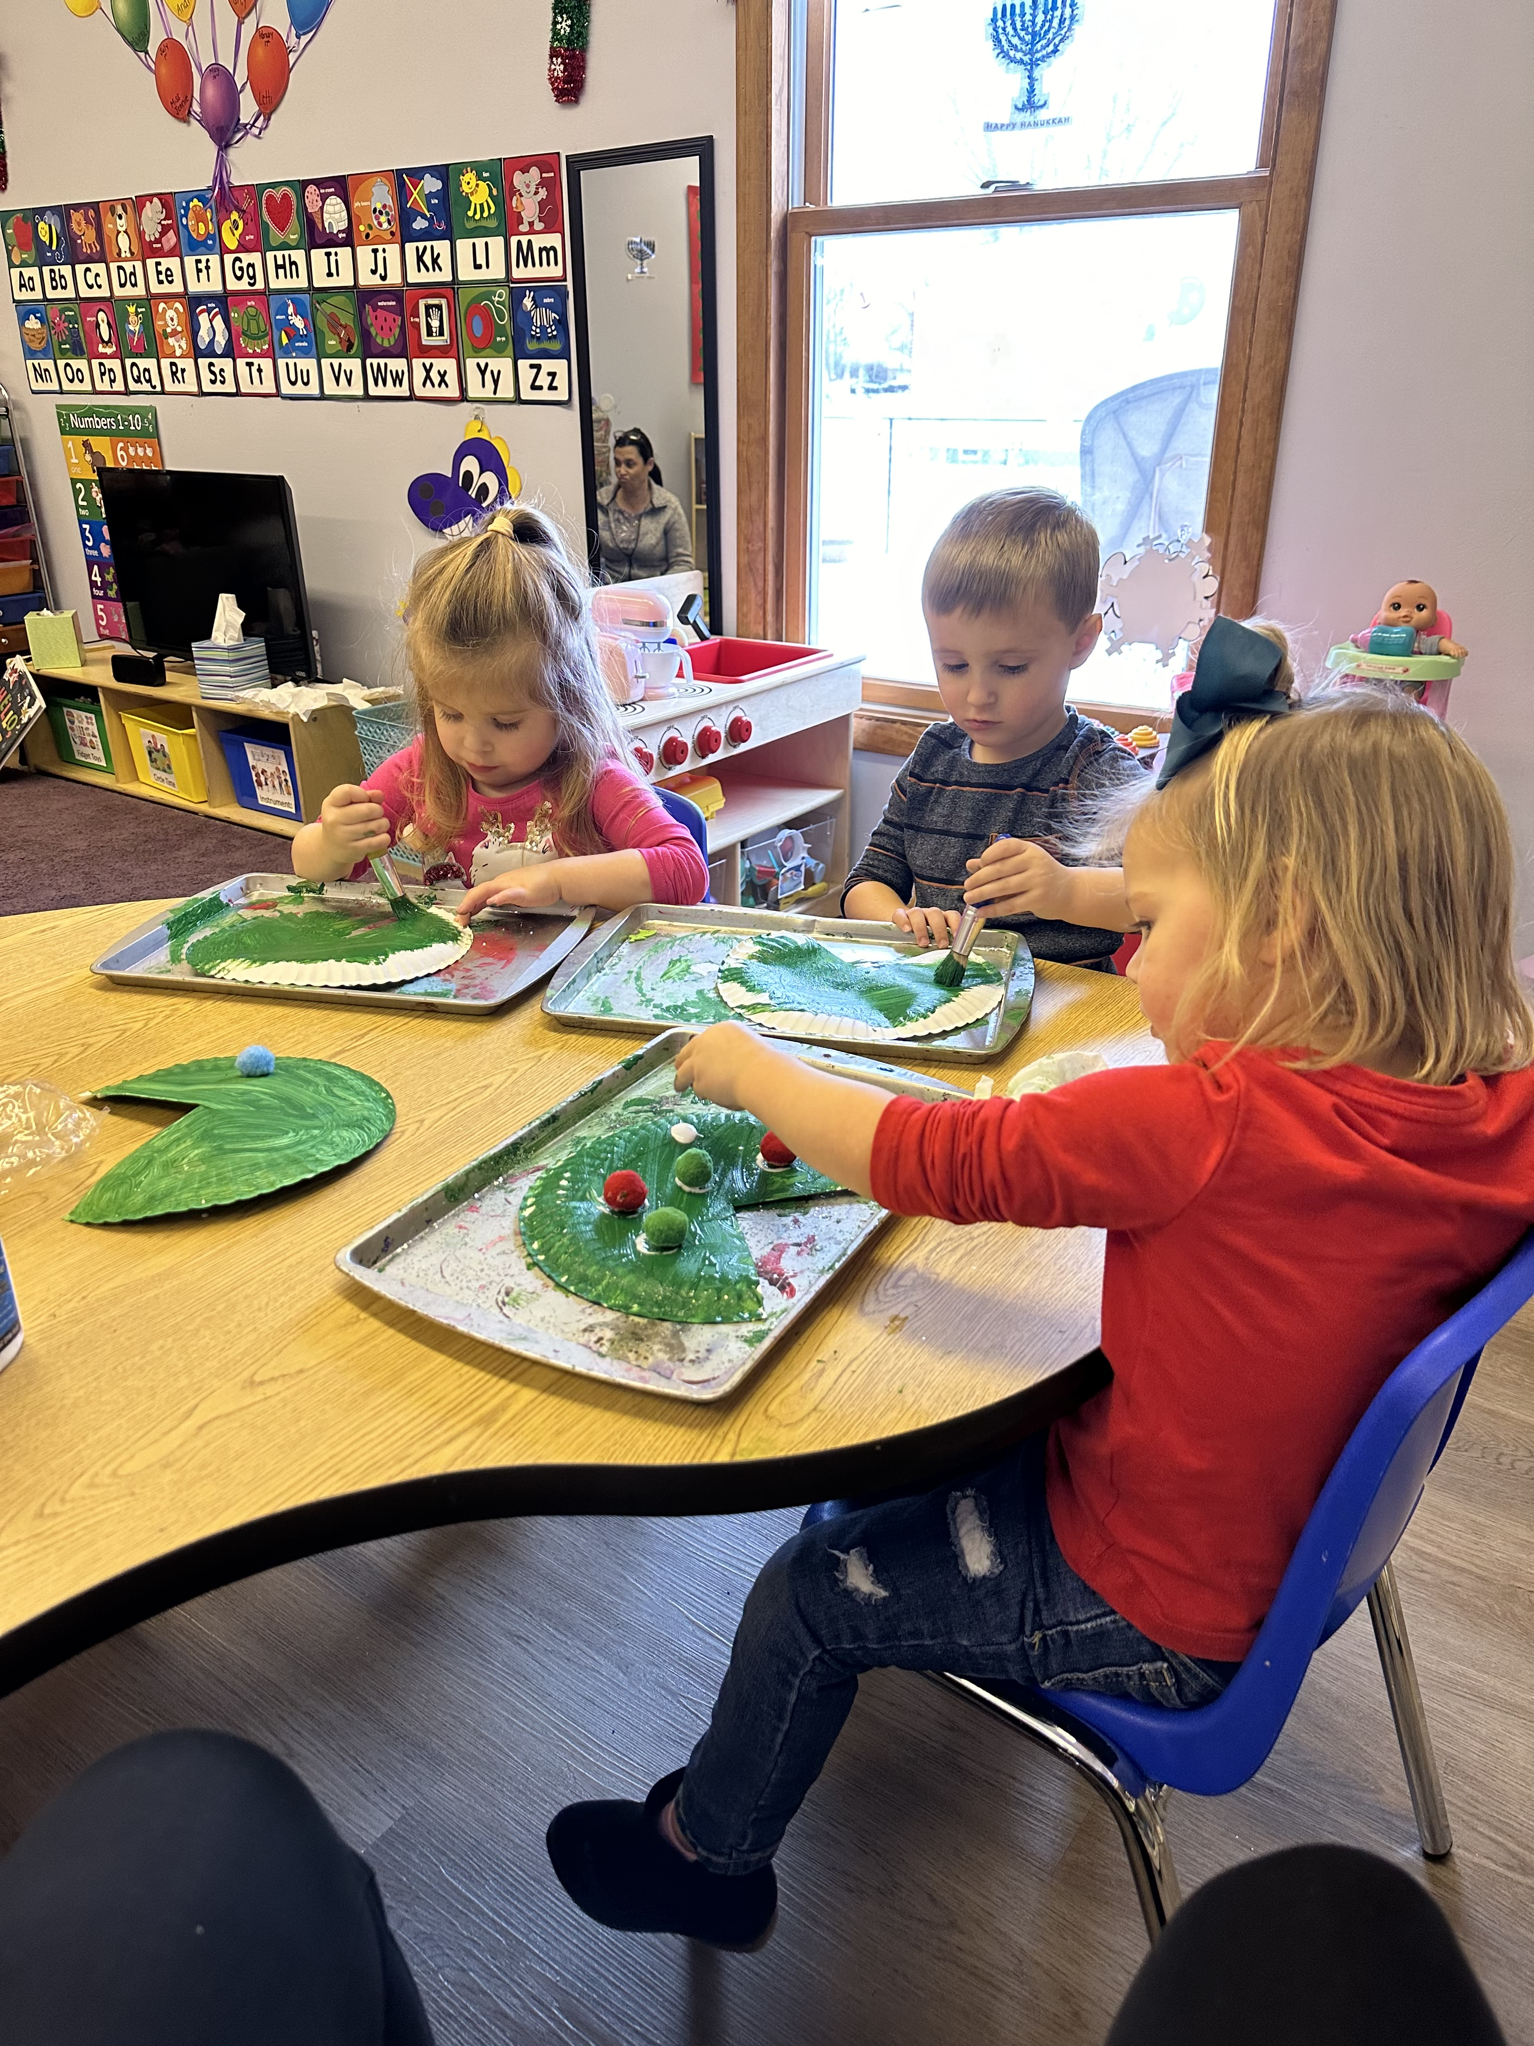
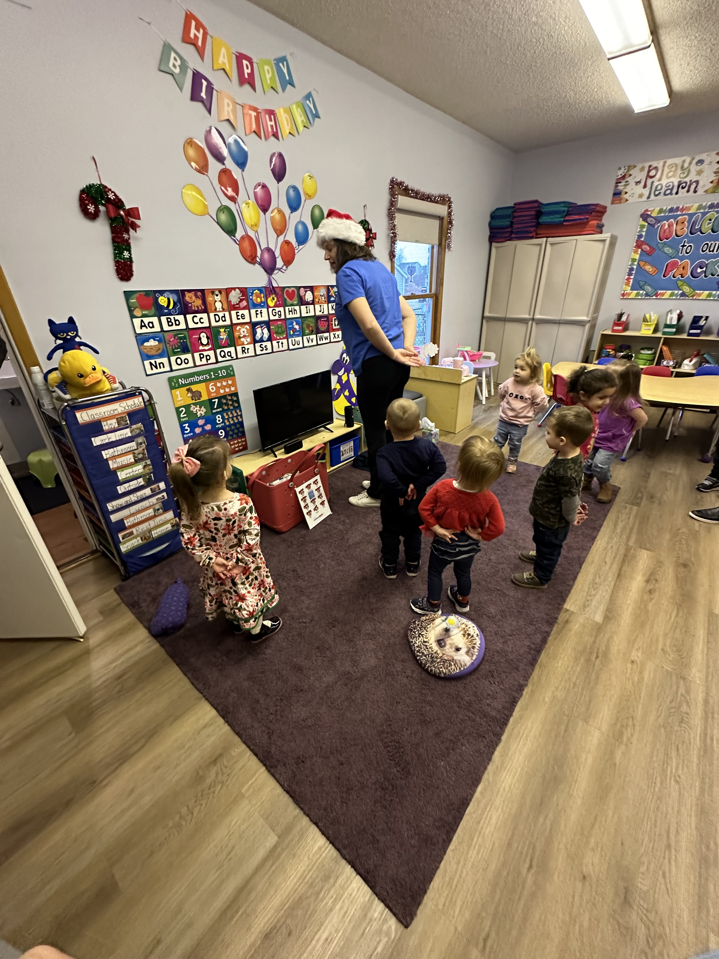
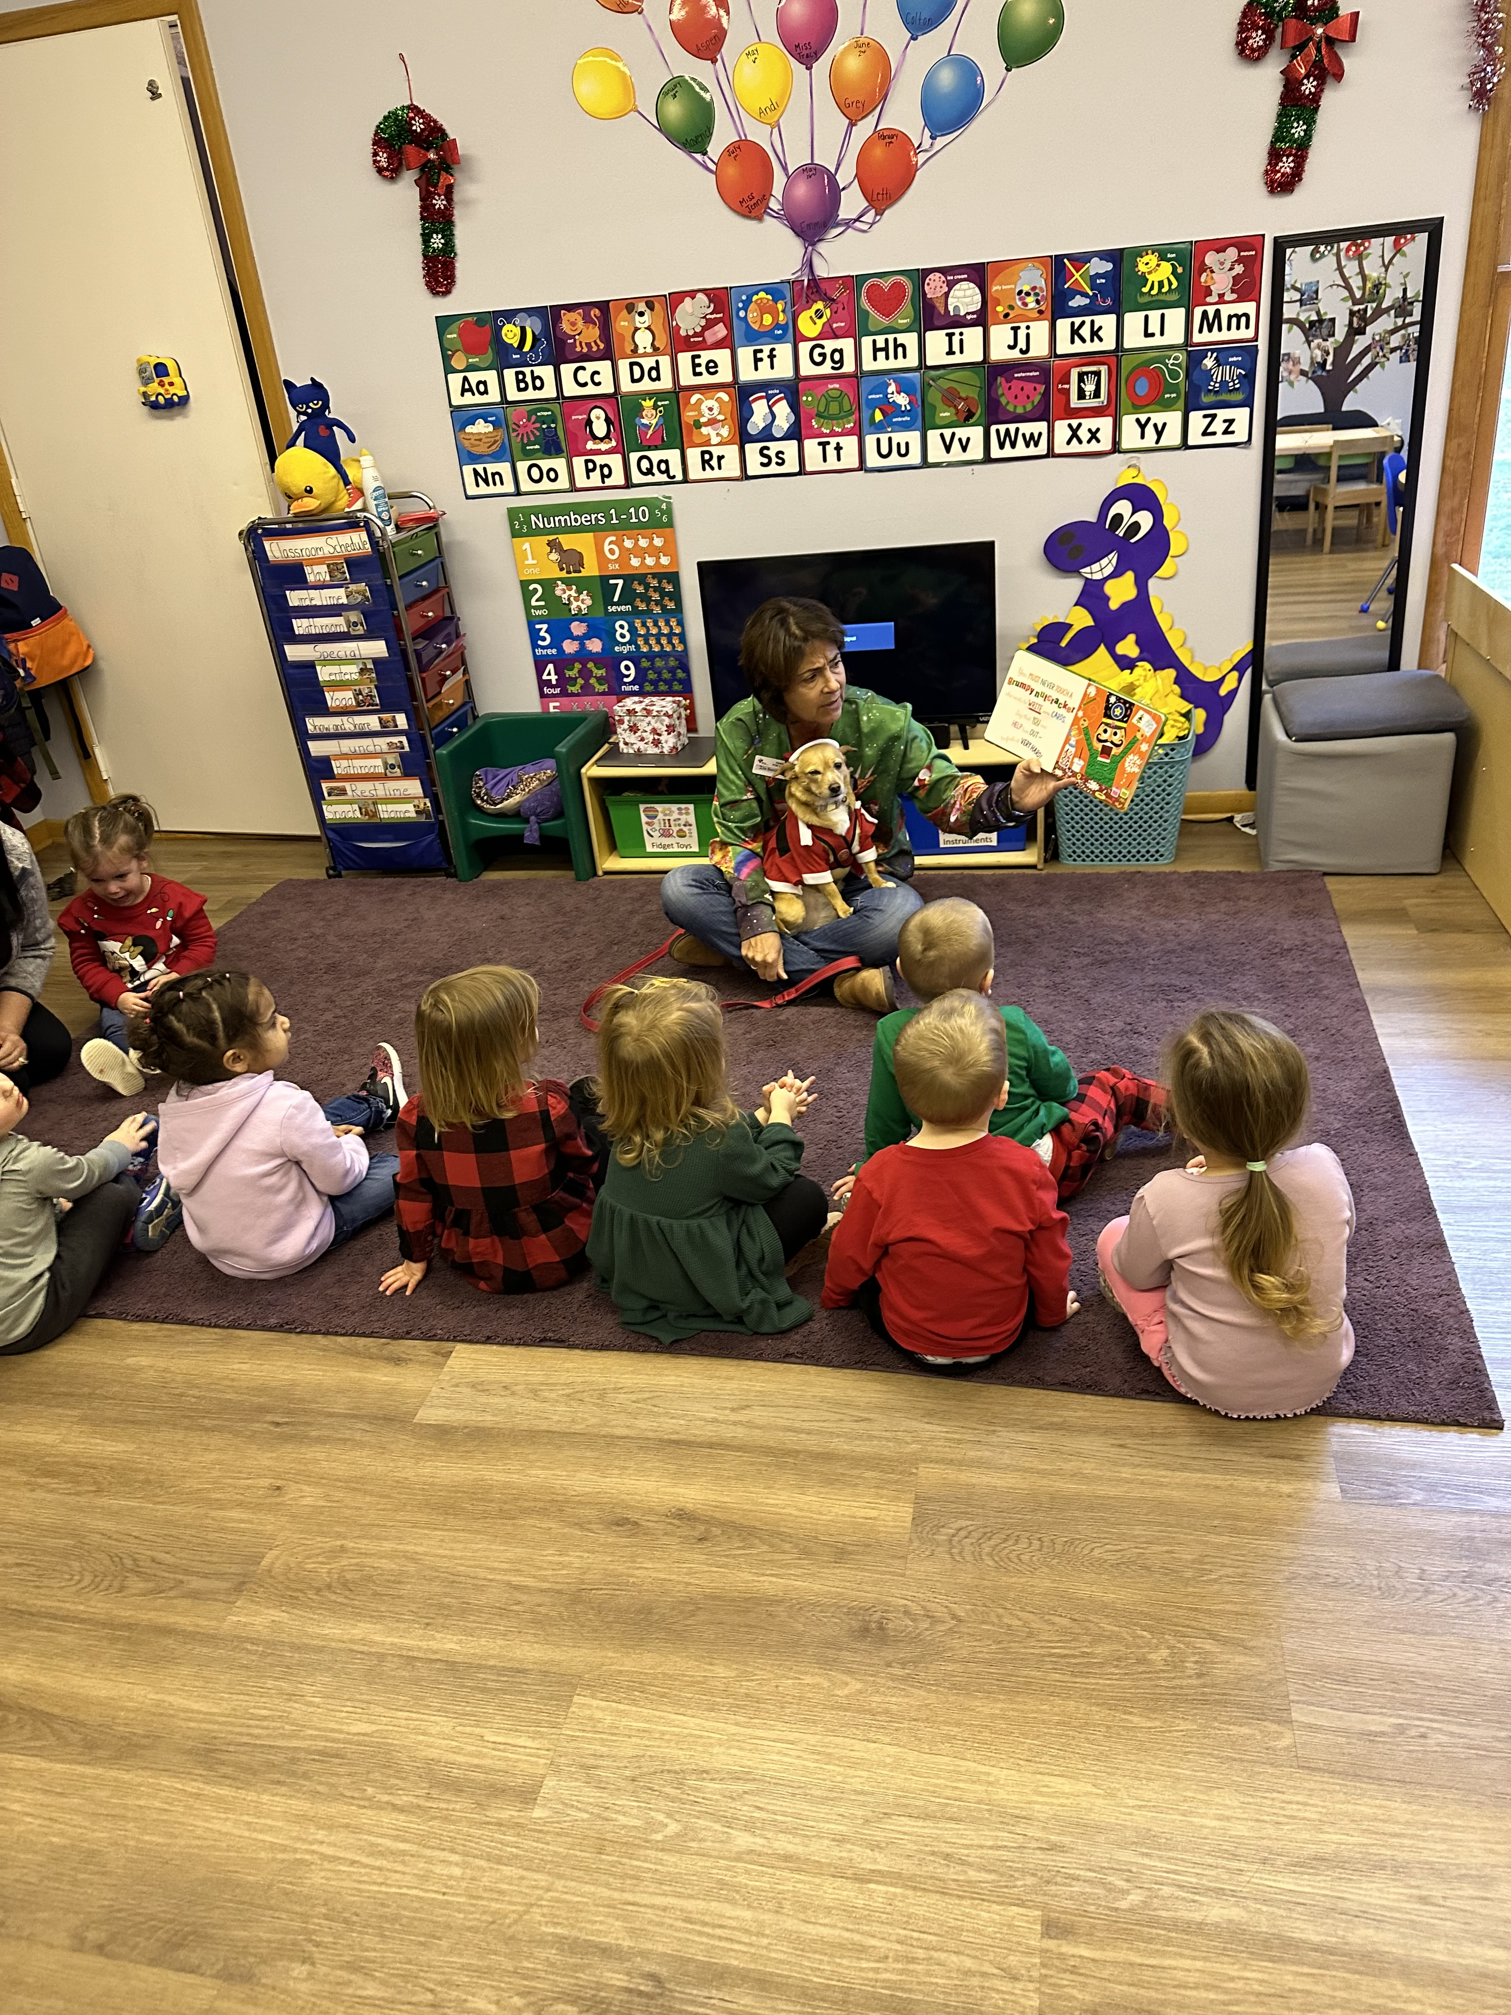
Pre-K 2 Newsletter
December 18th – 22nd
We had a great week!
This week we continued learning about Christmas!
The kiddos are very excited for Santa to come to their houses. We talked about how we leave milk and cookies out for Santa, but didn’t want to leave out Santa’s reindeer, so we made special reindeer food for them.
For our fine motor crafts, we did a great job making candy canes, Christmas trees, Santa masks, and reindeer.
On Monday, during music with Miss Katie, we danced to the “Reindeer Pokey” and ”Snowman Freeze” songs.
On Thursday, Miss Ilia and Charlotte came by to play in our centers with us. The kiddos loved seeing Charlotte dressed up in her Santa costume.
Some of the stories we read this week were:
LIama LIama Holiday Drama, HELLO TREE, Christmas Peekaboo, This Little Reindeer, and Never Touch a Grumpy Reindeer
Next month we will be learning about the
color blue and the rectangle shape.
Reminders
December 25^{th-} January 1st
No School
Christmas Break
January 15th
No School
Martin Luther King Jr. Day

